Slide 1
Weekly report
Week 10 (1/1/2014-8/1/2014)
1/6
Admission system – DeadlineTeam – Mentor: Mr. Bui Minh Phung

Slide 2
Agenda
Last week’s accomplishments
Plan for next week
2/6
Admission system – DeadlineTeam – Mentor: Mr. Bui Minh Phung

Slide 3
Last week’s accomplishments
Update architectural drivers specification :
- Quality Attributes
- Usecases
- Entities
Design system context
Implement architect : 3 perspectives
    Physic
    Dynamic
    Static
3/6
Admission system – DeadlineTeam – Mentor: Mr. Bui Minh Phung

Slide 4
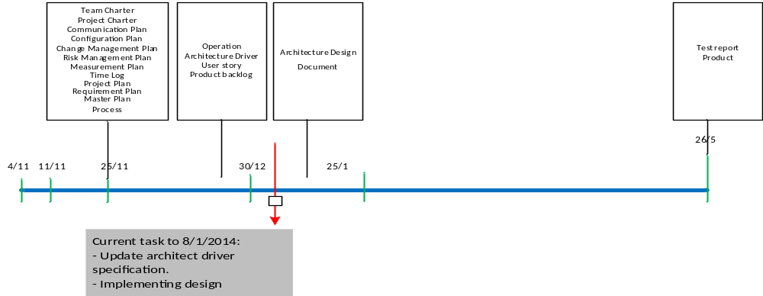
Last week’s accomplishments
3/6
Admission system – DeadlineTeam – Mentor: Mr. Bui Minh Phung

Slide 5
Effort measurement
3/6
Admission system – DeadlineTeam – Mentor: Mr. Bui Minh Phung

Slide 6
Plan for next week
Continue design Static and Dynamic View next level
Continue training spring in java: lucense search
Design Interface
Mapping Dynamic and Static, Dynamic and Physical
Review with Customer: Review architecture design
Review with mentor about architect design
5/6
Admission system – DeadlineTeam – Mentor: Mr. Bui Minh Phung

Slide 7
Thanks for your attention

